Slide 1

Contrasting Cultural Values
by
Dr. Vijai N. Giri
Professor of Communication Studies
Dept. of Humanities & Social Sciences
IIT Kharagpur
email: vng@hss.iitkgp.ernet.in

Slide 2
Values
Values form the core of the culture. Values are social principles, goals, or standards accepted by persons in a culture. They establish what is proper and improper behaviour as well as what is normal, and abnormal behaviour.
Values are learned by contacts with family members, teachers and religious leaders. What people hear, read, and watch on television influences their value systems.

Slide 3
Values
People in various cultures have different attitudes towards women, ethical standards, and work. Semantic differences, and attributions affect cultural values as do religious influences.

Slide 4
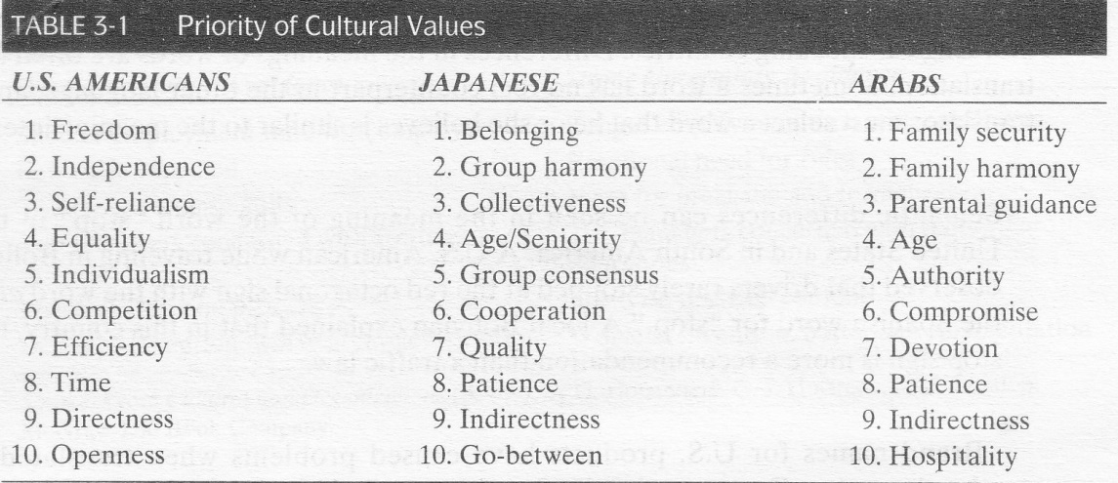
Priority of Cultural Values

Slide 5
Semantic Differences
Semantics is the study of the meaning of words; it involves the way behaviour is influenced by the use of words and nonverbal methods to communicate.
Words in the English language often have multiple meaning, some of which are contradictory. The world sanction, for example, may mean either to restrict a particular activity or to authorize it.
Semantic differences are compounded when interacting with people of other cultures. Even when both speak the same language, a word may have a different meaning.

Slide 6
Semantic Differences
Although England and Australia are English-speaking countries, words are often used in a different way in these countries from the way they are used in the United States.
The word homely, for example, means “plain” in the United States, although in English it means friendly, warm, and comfortable.
To the English, a sharp person is one who is devious and lacking in principles rather than one who is quick, smart and clever in the United States.
The expression “quite good” has a different meaning to the English than to US Americans. The English interpretation is “less than good”, although the US meaning is “very good”.

Slide 7
Attribution and Perception
Attribution, or the ability to look at social behaviour from another culture’s view, can cause communication problems because known experiences from our own culture are used in explaining unknown behaviours of those in another culture.
Perception the learned meaning of sensory images, may involve learning a new reaction to an old learning stimulus.
To lessen anxiety when communicating with someone of an unfamiliar culture, reducing uncertainty and increasing predictability about your own and the other person's behaviour are important.

Slide 8
Attribution and Perception
Attribution training involves making people aware of their own cultural context and how it differs from the cultural context of the country to which they will travel.
Measuring employees’ attribution confidence, and then training them to be cognizant of their personal differences with the assignment culture, is often used to prepare employees for overseas assignment.

Slide 9
Attitude Towards Women
Attitudes are our likes or dislikes to certain people, objects are situations. Attitudes are rooted in our behaviour and in our emotions. Sometimes our personal attitudes may differ from those of the macro-culture or dominant culture.
The society’s attitudes towards women are influenced by cultural roots. In some cultures, such as the United States, women are supposed to have the same rights as men. in other countries, such as Libya and Kenya, women are considered subordinate to men. In fundamental Islamic cultures, woman are allowed to work only with other woman.

Slide 10
Attitude Towards Women
The attitude towards a woman’s role in society is carried out into the workplace. In the United States, gender differences in the workplace are deemphasized. The women’s rights movement has worked for such legislation as fair employment laws requiring that men and women must be given equal pay for equal work.
Although some women in various countries may have received their first job opportunities from family or political connections, other advanced because of professional qualifications and job competence. Major problems women in the workforce have faced, such as childcare and trying to combine a career and family, are common to all cultures.

Slide 11
Work Attitude
Attitudes towards work are culturally diverse. The term work attitudes refers to how people of a culture view work. Work defined as mental or physical activities directed to socially productive accomplishments, in some societies is associated with economic values, status and class, and cultural values.

Slide 12
Work Attitude
The attitude of Japanese men towards work is very group oriented, and it plays a major role in their lives. They work Monday to Friday; 18-hour days are not unusual.
Because of the long hours, relaxation does not include working around the house. Instead they relax by watching television, playing computer games, browsing the Internet, drinking, or joining their friends at the local bar. However, this attitude appears to be changing as they become more westernised.

Slide 13
Attitudes towards Ethics
Ethical standards are guidelines established to convey what is perceived to be correct or incorrect behaviour by most people in a society.
Ethical conduct is something judged as proper or acceptable based on some standard of right and wrong.
Being ethical means keeping your values in balance; If you compromise your values, you are being unethical.

Slide 14

Attitudes towards Ethics
Personal ethics are moral standards may differ from societal ethics. Your own standards of what is right and wrong may be more stringent than those are for society as a whole.
Problems may occur when the reverse is true, that is, when your ethical standards are lower than those considered acceptable by society. Of course, your ethical standards must meet the minimum level of behavior identified by law as acceptable.

Slide 15
Religious Influences
Religious influences have an impact on when and how business is conducted in international settings. In some cultures, such as North and South America, Australia and Europe, lifestyle and religion are separate.
In much of Northern Africa and Southern Asia, no distinction is made between lifestyle and religion because religion is a lifestyle. Businesspersons in these countries may seek the advice of religious leaders on business matters.

Slide 16
Religious Influences
Religious beliefs and practices affect business in many countries. Although both the United States and Italy are primarily Christian countries, religious Holidays are more numerous in Italy than in the United States.
Sri Lanka, for example, has 27 Holidays. Religious beliefs also affect consumption pattern; for example, Hindus do not eat beef and Muslims and Orthodox Jews do not eat pork. When conducting business internationally, religion must be considered.

Slide 17
Conclusions
Thus, it can be said that one should learn how to communicate effectively with persons from other cultures, and understand the differences in word meanings among cultures.
It is important to understand how attribution and perceptions play a role in cultural values.
We have to appreciate attitude differences towards men and women in various cultures and understand how attitudes towards work and ethics vary with the culture.
Further, it is very essential to learn how religious influences impact cultural values in different cultures.

Slide 18

Thank You !

